Slide 1

ATM-to-Bank Server Communication Simulation
Presented By:
Pradeesh selvan V-1925260027
Guided By: Dr. K. Jai Sharma
Kavin P | - | 1965260051
Nibraz M | - | 1965260001

Slide 2


TABLE OF CONTENT
•ABSTRACT
•INTRODUCTION
•MODULES IMPLEMENTATION
•RESULT
•CONCLUSION

Slide 3

ABSTRACT
•Simulates communication between ATMs and a central bank server.
•Uses 3 ATMs connected through a router.
•Implements ATM transactions such as balance checking and withdrawal.
•Uses a web application to demonstrate the bank-server operation.
•Uses Wireshark to analyse network traffic.
•Identifies plaintext data risks and recommends TLS encryption.

Slide 4

INTRODUCTION
•ATMs need to communicate with a bank server to process transactions.
•The ATM sends a request to the bank server.
•The server checks the account and processes the request.
•The server sends approval or denial back to the ATM.
•The project demonstrates this process using networking and software tools.

Slide 5

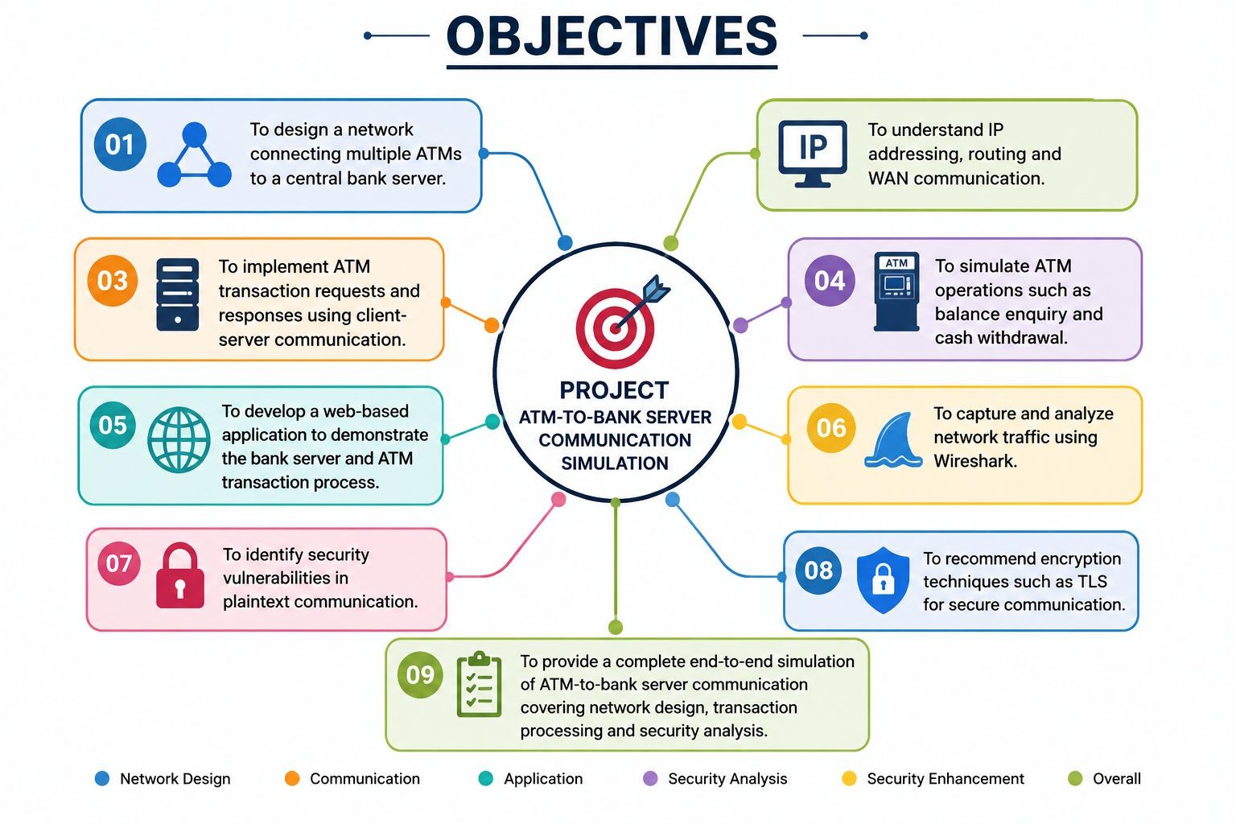
MODULE IMPLEMENTATION

Slide 6
MODULE 1 - ATM Network Topology Design
Purpose
Demonstrates the physical/network connection between ATMs and the bank server.
Implementation
Created the topology using Cisco Packet Tracer.
Added 3 ATM machines.
Added a router for network communication.
Added a central bank server.
Configured IP addresses.
Tested connectivity using ping.
Flow
ATM → Router → Bank Server
Result
All three ATMs can communicate with the central bank server.
Demonstrates IP addressing, routing and WAN communication.

Slide 7
MODULE 2-Transaction Request-Response Program
Purpose
Demonstrates how an ATM sends transaction requests to the bank server.
Implementation
ATM works as a client.
Bank server works as a server.
Communication uses TCP socket programming.
Server receives and processes requests.
Server sends a response to the ATM.
Transactions
Check Balance
ATM requests account balance.
Server returns the available balance.
Withdraw
ATM sends withdrawal amount.
Server checks available balance.
Transaction is approved or denied.

Slide 8
MODULE 3 -Security Gap Analysis Using Wireshark
Purpose
Checks whether ATM transaction data is securely transmitted.
Implementation
Captured ATM-server traffic using Wireshark.
Applied TCP/port filters.
Used Follow TCP Stream.
Inspected packet payload.
Checked whether transaction information was visible.
Security Issue
Plain TCP communication can expose application data.
Sensitive information may be visible in captured packets.
This creates a confidentiality risk.
Solution
Use TLS encryption.
Encrypt communication between ATM and bank server.
Prevent attackers from easily reading captured data.

Slide 9
RESULTS
•Three ATMs successfully connected to the bank server.
•Router provided communication between networks.
•ATM transaction requests were processed.
•Balance enquiry was successfully simulated.
•Withdrawal approval/denial was demonstrated.
•Web application provided an interactive demonstration.
•Wireshark successfully captured network traffic.
•Plaintext communication security risk was identified.
TLS encryption was recommended.

Slide 10
CONCLUSION
•Successfully simulated ATM-to-bank server communication.
•Demonstrated network connectivity using Cisco Packet Tracer.
•Implemented transactions using client-server communication.
•Developed a web-based working model.
•Analysed network traffic using Wireshark.
•Identified the risk of plaintext communication.
•Recommended TLS encryption for secure banking communication.
•The project combines Networking + Programming + Web Application + Cybersecurity.

Slide 11
THANK YOU

